Slide 2


Price is
a range
Your NET depends upon your agent

Slide 3

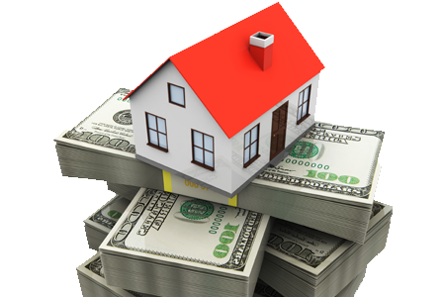
Pricing Your Home
Price is a “Range”
Don’t believe anyone who has the “Right Price”
The objective is to get to
the top of the “Range”

Slide 4


Whose opinion counts least?
Seller
Buyer
Appraiser
Agent

Slide 5
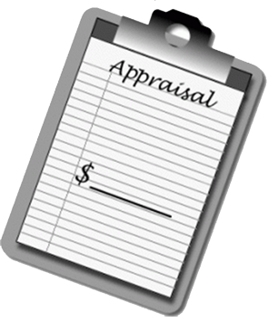

The Problem A Seller Faces
Appraiser’s Opinion Of Value
Versus Buyer’s Opinion Of Value
Buyer
Appraiser
$250,000
$230,000
Appraiser
Buyer
I work hard to help you get the most from your house.

Slide 6


The 2 Most Important Issues
It is easier to go down than to come up
The Market will tell us if the price is right

Slide 7


We Have To Create A Partnership
There are certain things that you will control
and certain things that I will control.

Slide 8

Your Job
My Job
Be the Employer
Set the initial price based on market
Be comfortable with the initial price
Expose your house to the entire market
Listen to what the market tells us
Report to you

Slide 9
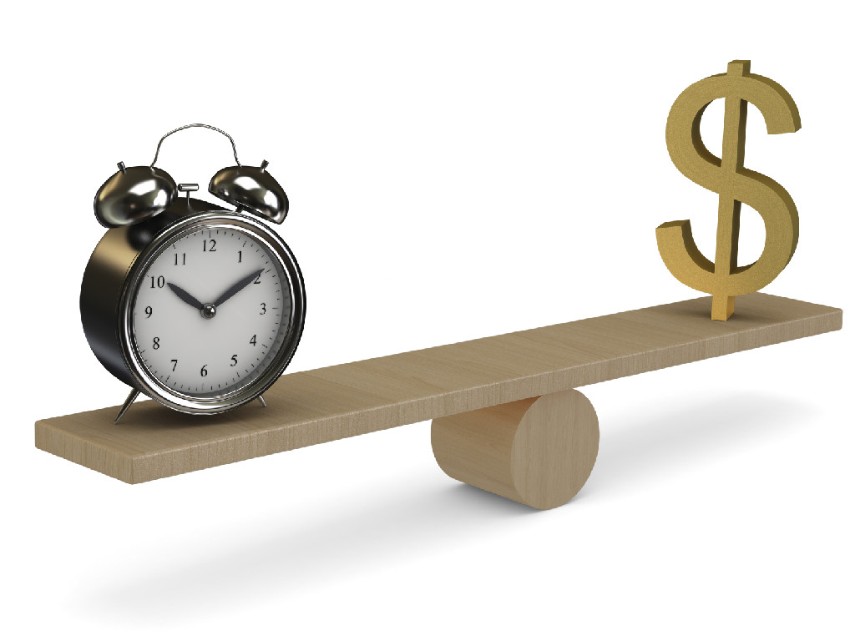
VALUE
TIME

Slide 10


uccessfully Selling your home for maximum value.
Right agent
Leading Real Estate Company
Proven Marketing Plan
Time to position your home!
Stand out! Be the competition!
Buyers are waiting!

Slide 11


Price is a Strategy–
Position your home for
Maximum Value
Unsold Competition Active listings still in the market
Pending Sales that will affect your Appraisal
Sold properties -identify Sales to be used to justify the sale price on your house.
Market Rejected Homes - houses that expired and have not sold.
Days on Market as it relates to a higher List Sold price

Slide 12

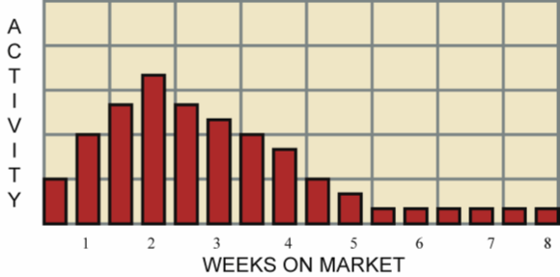
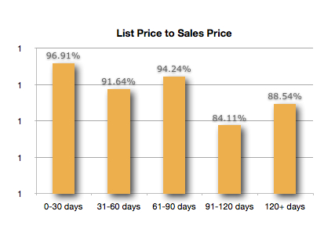
The first 14 days are
CRITICAL

Slide 13

Who is involved in determining
Value on a house?
Seller
Buyer
Appraiser
Agent

Slide 14


Stand out
amongst your competition!
    Condition
    Market Position
    Proven Marketing
    Strategy

Slide 15
Your Job
My Job
Be the Employer
Set the initial price based on market
Be comfortable with the initial price
Expose your house to the entire market
Listen to what the market tells us
Report to you

Slide 16

LET’S GET
STARTED!

